Slide 1
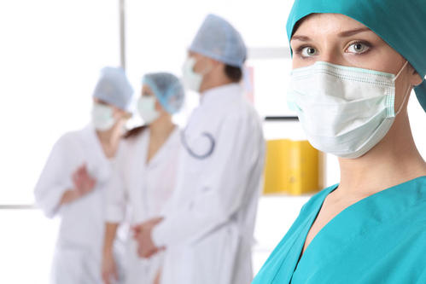
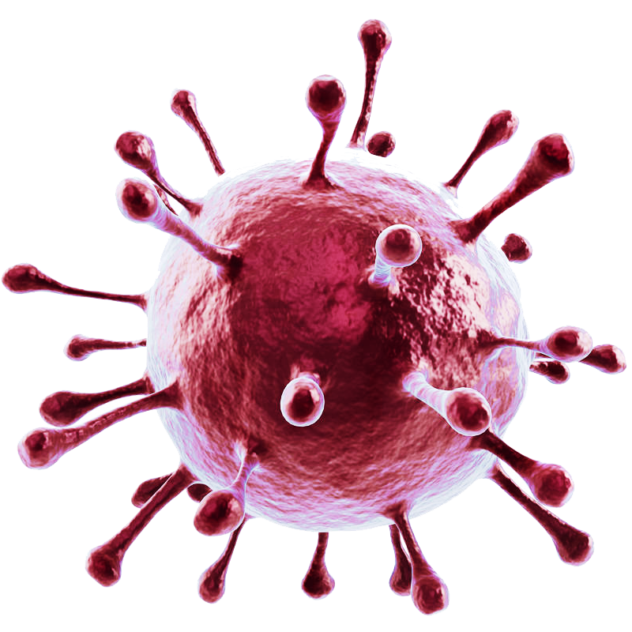
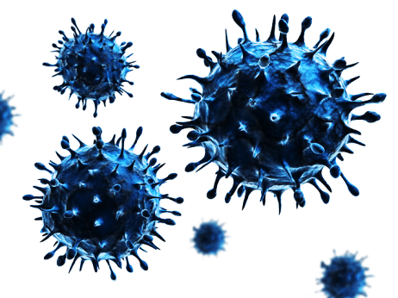
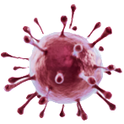
Covid-19
Awareness

Slide 2


CONTENTS
01
ABOUT
02
Condition symptoms
03
Covid-19 Awareness Project

Slide 3
01
ABOUT COVID-19
.

Slide 4
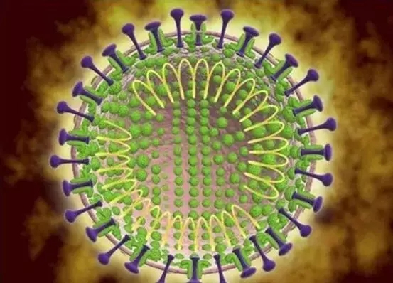
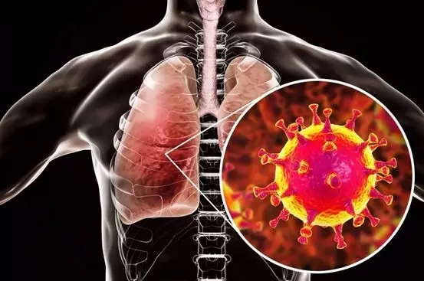
Condition symptoms

What is the covid-19 ?
Coronavirus disease (COVID-19) is an infectious disease caused by the SARS-CoV-2 virus. Most people infected with the virus will experience mild to moderate respiratory illness and recover without requiring special treatment. However, some will become seriously ill and require medical attention.
How harmful is a coronavirus infection?
The proportion of severe illness and death is low, and their transmission and pathogenicity are currently lower than the SARS epidemic in 2003.

Slide 5
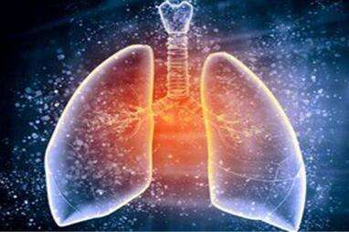
02
Condition symptoms
.

Slide 6
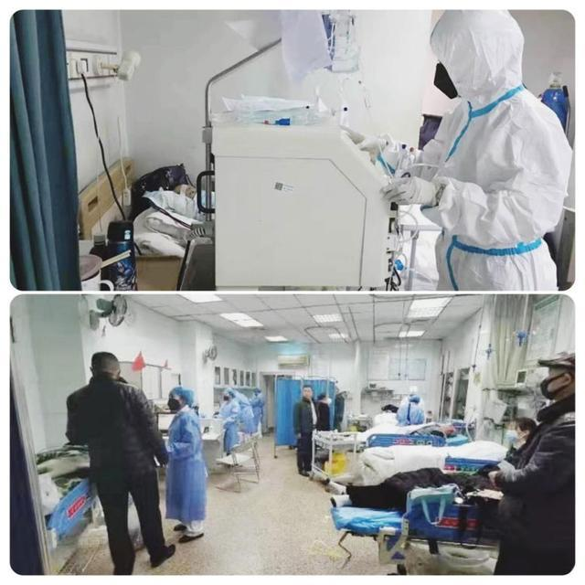
Condition symptoms
 Features
Does early clinical manifestation mean that you are infected
The appearance of fever, fatigue, and dry cough does not mean that you have been infected.
However, if there are symptoms of acute respiratory infections such as fever (underarm temperature ≥37.3 ℃), cough, shortness of breath, and history of travel or residence, or patients who have been exposed to fever with respiratory symptoms from Wuhan within 14 days before onset, or If there is a small-scale clustered disease, it should be checked, diagnosed and treated at the local designated medical institution.

Slide 7
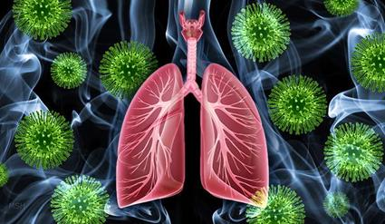
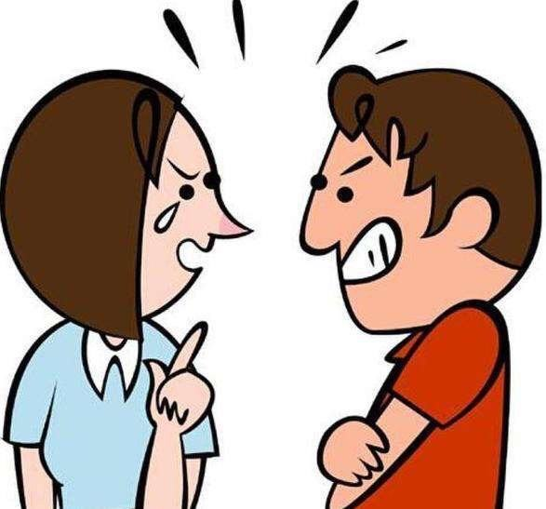
Condition symptoms
 Features
Are health care workers at risk from covid-19?
Yes, because health care workers are in greater contact with patients than the general public and are more vulnerable to new coronavirus infections, WHO recommends that health care workers always take appropriate infection prevention and control measures.

Slide 8
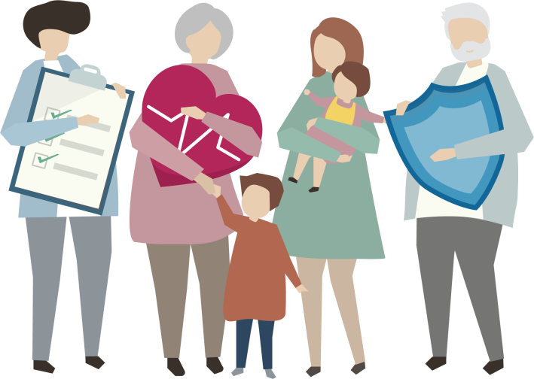
Condition symptoms
 Features
Will the virus spread from person to person?
Yes. The presence of human-to-human and medical infections is a very important sign. The reason for the increased number of cases is more complicated.

Slide 9

Condition symptoms
 Features
What to do if you are a close contact
close contact
One of the following contacts with onset cases (suspected and confirmed cases):
People who live, study, work or have close contact with the case
Medical staff, family members, or other people who have similar close contact with the case when they do not take effective protective measures during the diagnosis, treatment, and visit of the case
Other patients in the same ward and their accompanying staff
Travel in the same vehicle as the case and have close contact

Slide 10
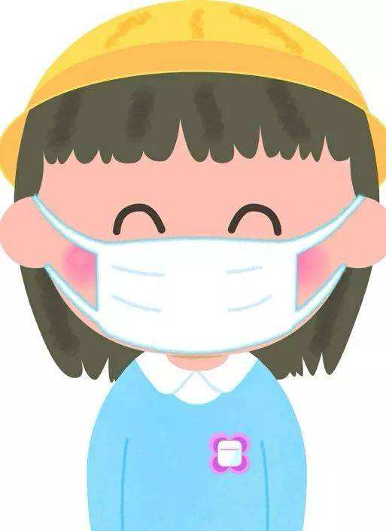
03
Covid-19 Awareness Project

Slide 11


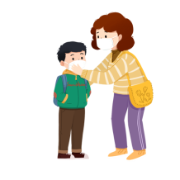

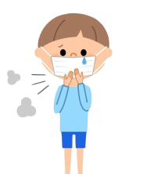

Defenses guide
 Defenses
Maintain hand hygiene. Wash your hands with running water, or use an alcohol-free hand sanitizer.
Defenses
Cover your nose and mouth with a tissue or elbow flexion when coughing and sneezing.
Defenses
Maintain indoor air circulation, and wear masks in public places and crowded places.
Defenses

Slide 12
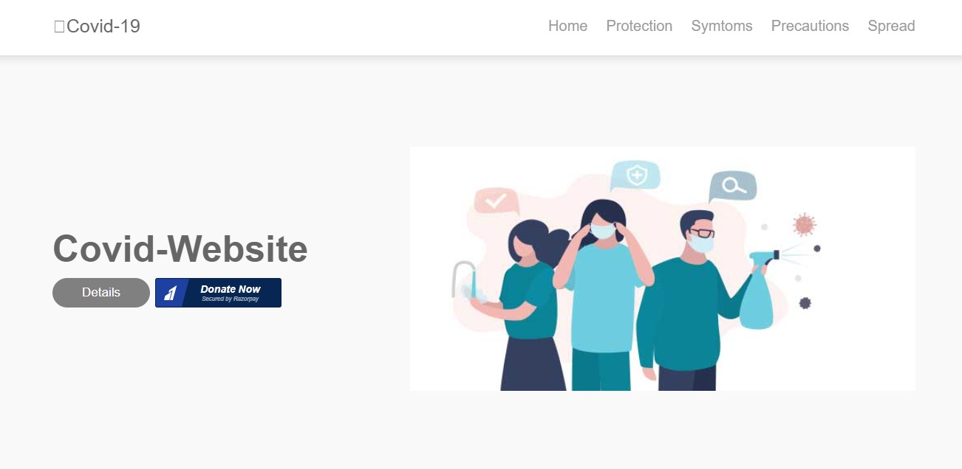
Covid-Website

Slide 13
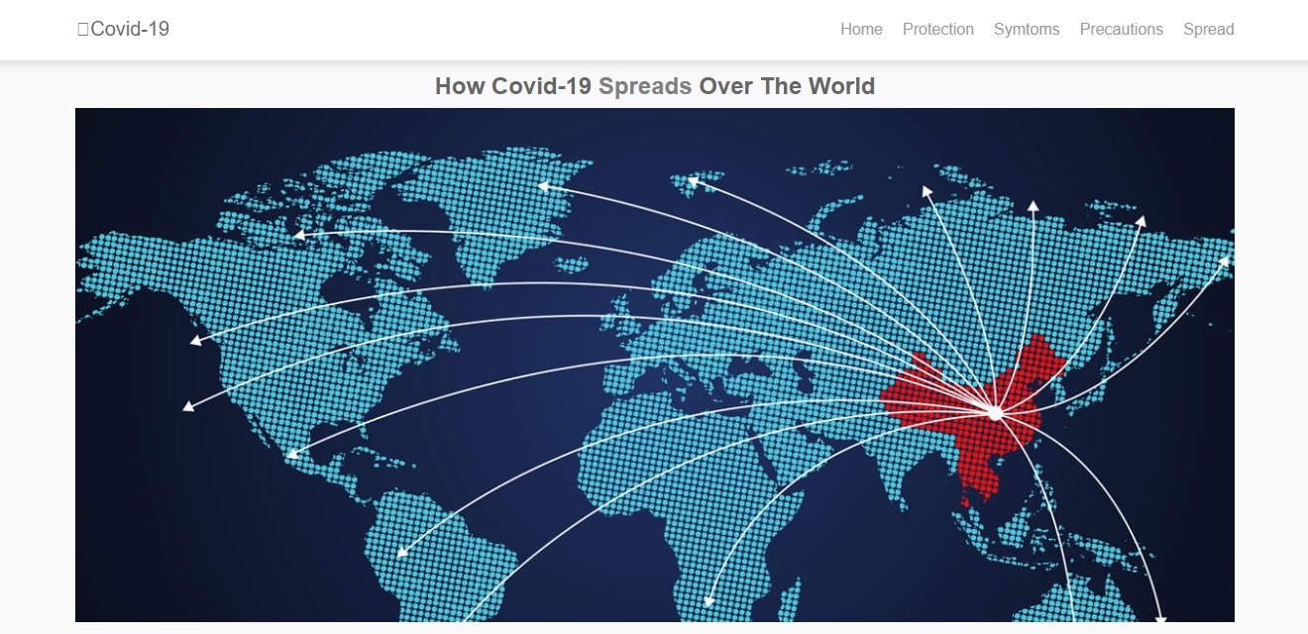

Slide 14
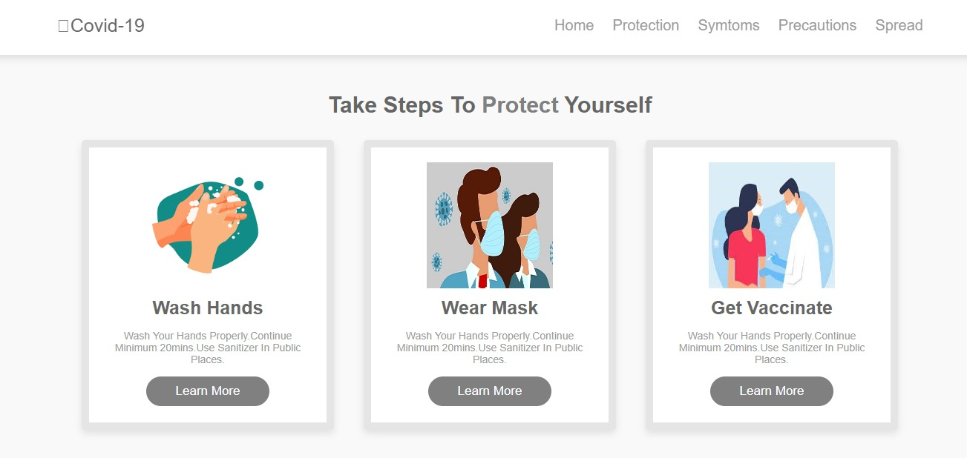

Slide 15
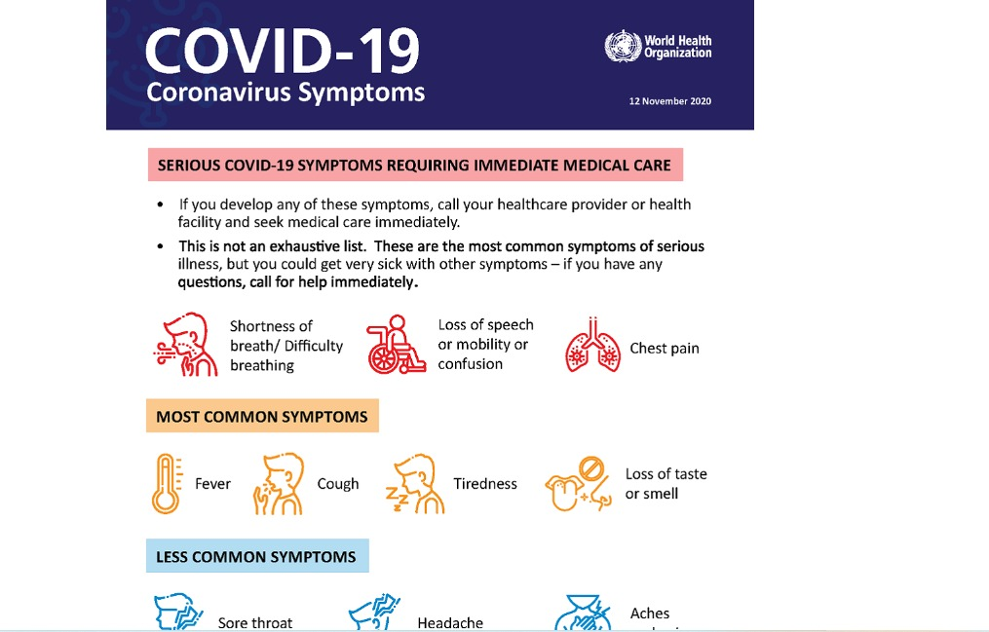

Slide 16
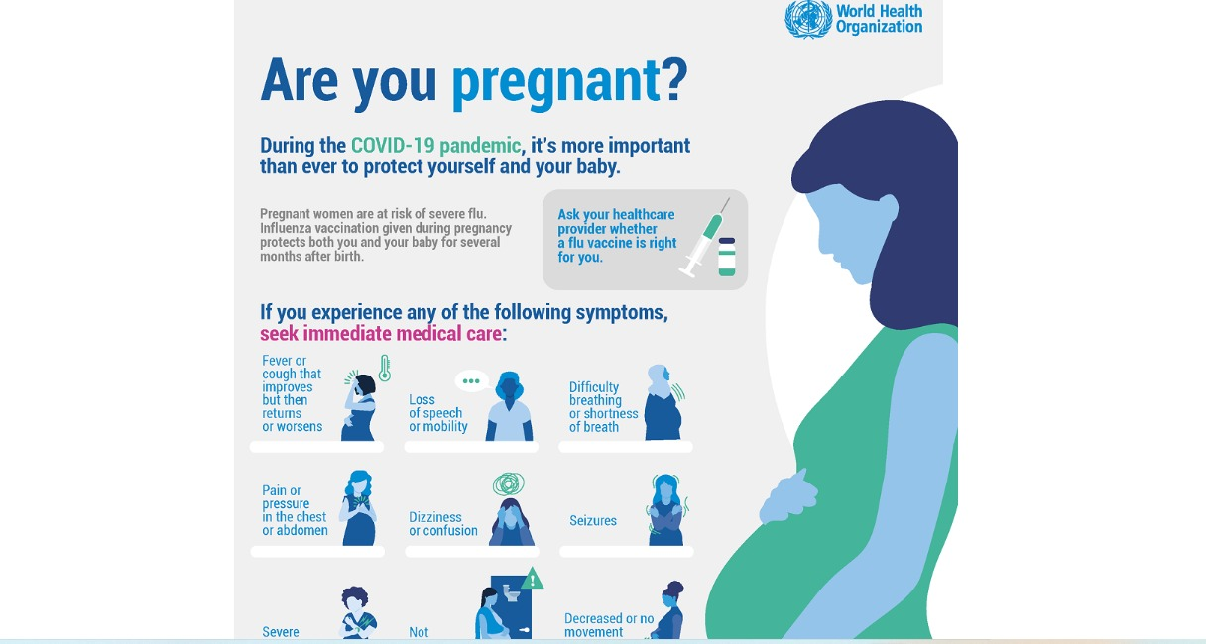

Slide 17
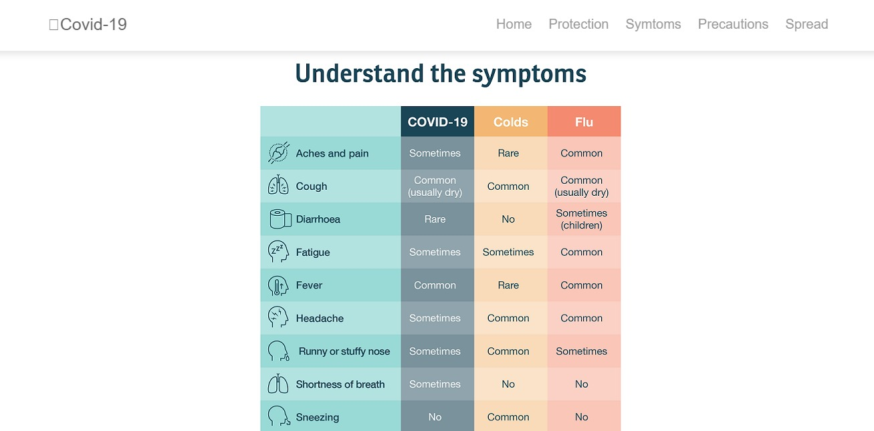

Slide 18
Thank You

